Slide 1
Analyzing Genomic Data with Databricks and SparkSQL
Team Members: Tom Bresee, Stephen Johnson, Joe Jiang

Slide 2
Context for our discussion – key questions
Spark is a fundamentally unified analytics engine for large-scale data processing
Basic Concepts
How is Spark different from other (competing) platforms?
Where does Spark fit in relation to file organization and RDBMS?
How can Spark be utilized?
Use Case
What is Spark doing to support the field of genomics?
What steps should be taken to implement Spark-based alignment tools?

Slide 3
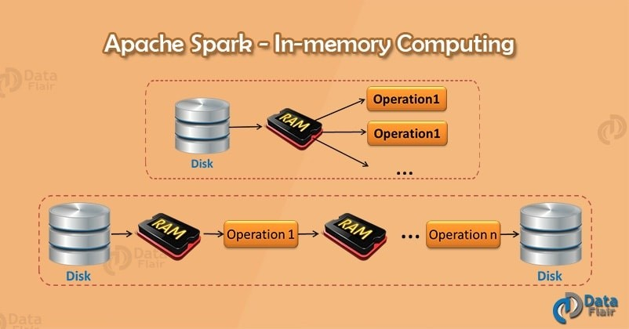
Spark’s unique approach leverages In-Memory Distributed Computing
RAM storage and parallel distributed processing
High fault tolerance and scalability
100X faster than MapReduce
Notes:
In-memory processing is an emerging technology for processing of data stored in an in-memory database. Older systems have been based on disk storage and relational databases using SQL query language, but these are increasingly regarded as inadequate to meet business intelligence (BI) needs.
When computing a result the same execution engine is used, independent of which API/language you are using to express the computation.

Slide 4
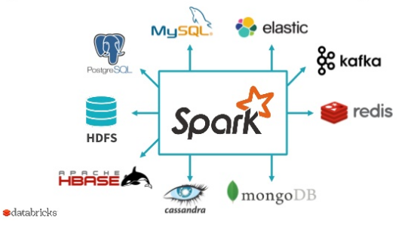
Spark is used for data processing, not storage
Connects to a variety of data sources, with the ability to process large volumes of structured and unstructured data as well as real time or archived
Process data with Spark APIs:
RDD
DataFrame
DataSet
Notes:
We’re going to be working with unstructured data – VCF (text file format with data lines containing information about a position in the genome)
Source: https://data-flair.training/blogs/apache-spark-rdd-vs-dataframe-vs-dataset/
We learned about:
MySQL, relational database
Hadoop, which offers superior storage for big data,
MongoDB, which is a document (row) oriented NoSQL database
Cassandra, which is a column-oriented NoSQL database
RDD – resilient distributed dataset (core of Spark)
DataFrame – table in a relational database (can write sql queries with API)
HDFS – distributed file system

Slide 5
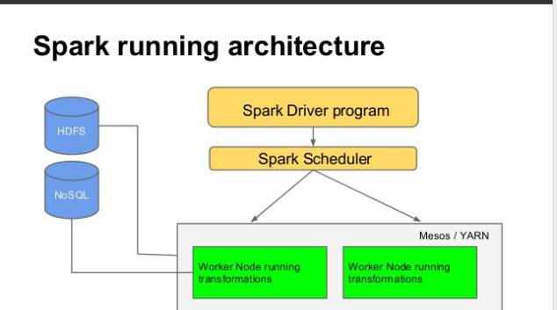
Spark architecture
Data Storage
Resource Management
API

Slide 6
Spark utilization is simple and easy
Open source
APIs include Scala, Java, Python, and R
Spark SQL module
When computing a result the same execution engine is used, independent of which API/language you are using to express the computation.
Notes:
https://www.linkedin.com/pulse/3-vs-big-data-volume-velocity-variety-what-ss-spark-kumar-chinnakali/
https://spark.apache.org/docs/latest/sql-programming-guide.html
https://spark.apache.org/docs/2.3.1/api.html

Slide 7
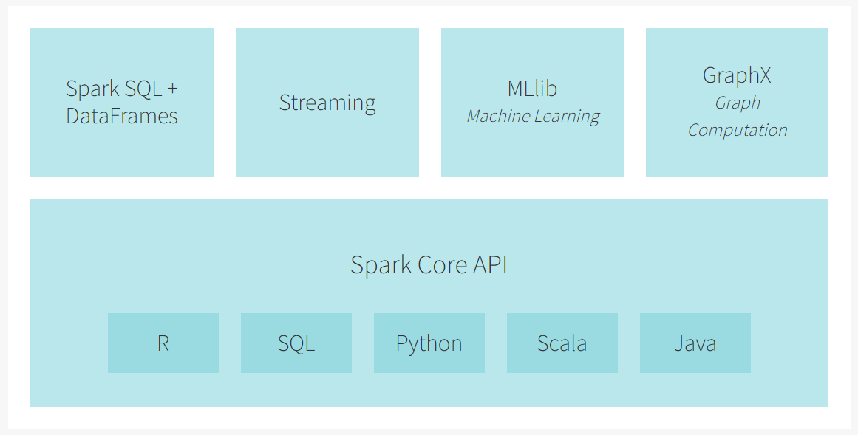
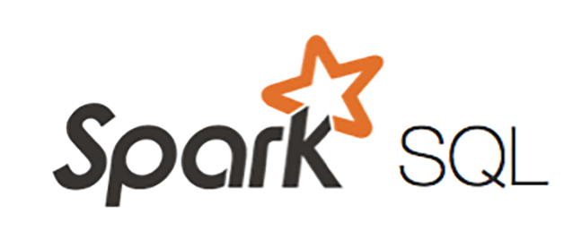
Our Foundation: In Memory Distributed Computing !
The Spark Engine
Apache Spark is a unified analytics engine for large-scale data processing.
Notes:
Validate with Sudheer to confirm the data flow
Verify sources – note the big ones, small ones we show others

Slide 8
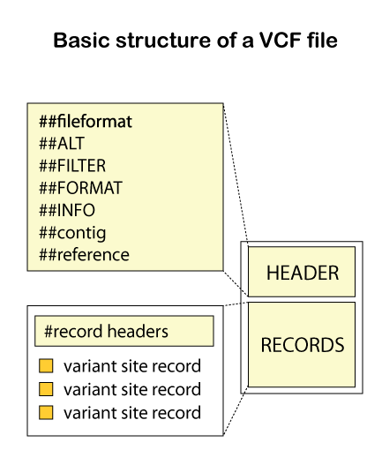
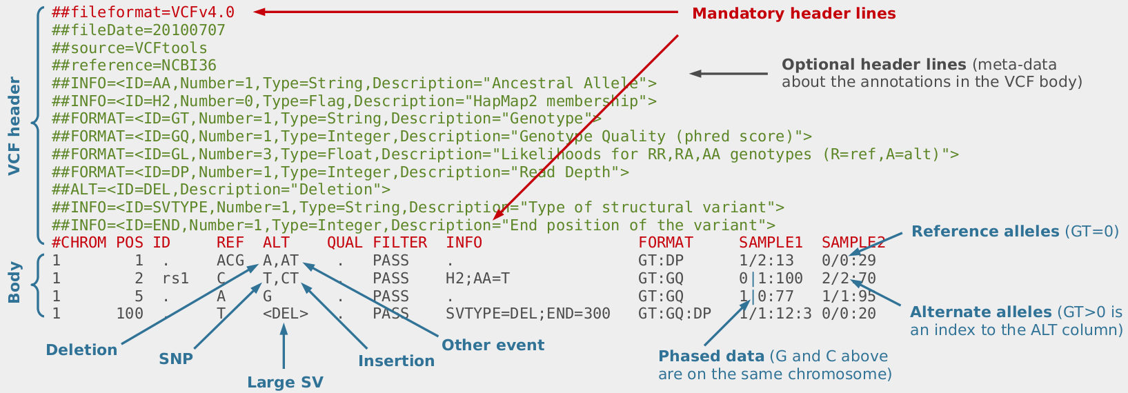
The Types Of Files We Are Looking At Are Complex !

Slide 9
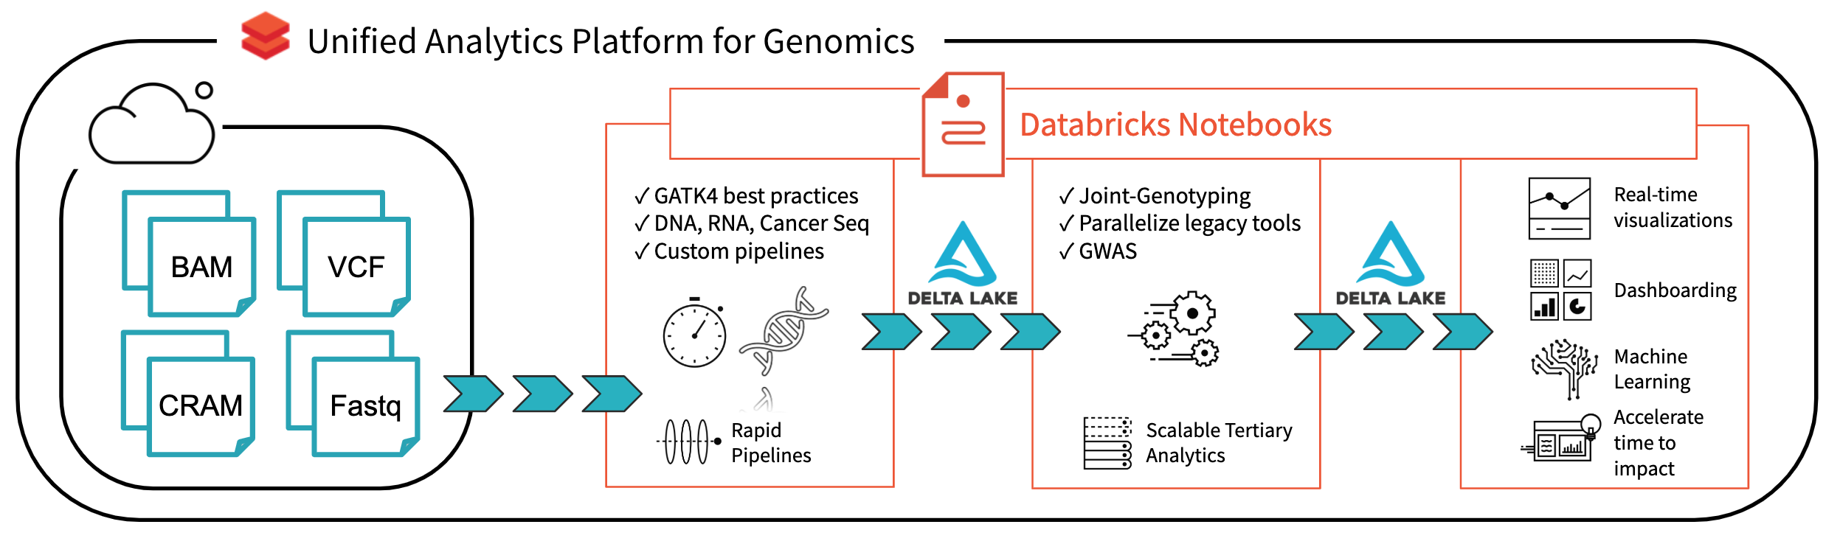
Notes:
Validate with Sudheer to confirm the data flow
Verify sources – note the big ones, small ones we show others

Slide 10
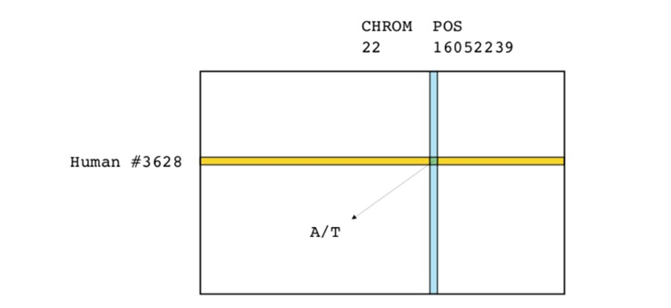
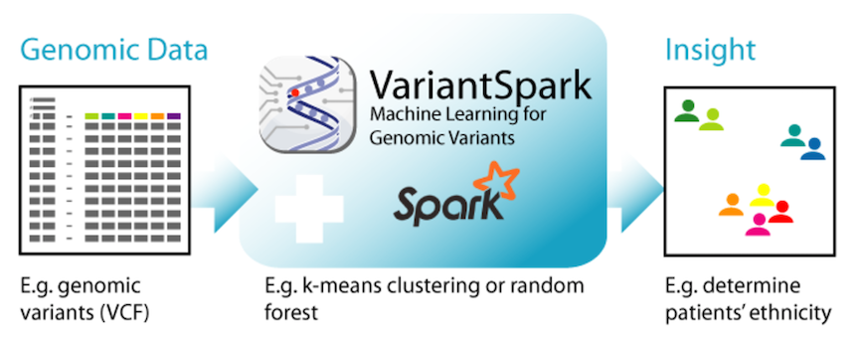
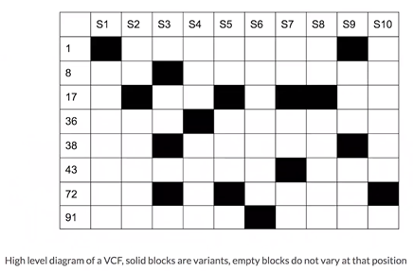
Structure of Variant Data
Notes:
Validate with Sudheer to confirm the data flow
Verify sources – note the big ones, small ones we show others

